Slide 1
Content Based Image Retrieval (CBIR)
PROJECT BASED LEARNING
Mentor:-
-Dr. B.S Daga

Slide 2
What is CBIR?
Content-based image retrieval (CBIR) is the application of
computer vision to the image retrieval problem, that is, the
problem of searching for digital images in large databases.
"Content-based" means that the search will analyze the actual contents of the image. The term 'content' in this context might refer colors, shapes, textures, or any other information that can be derived form the image itself.

Slide 3
What is OpenCV?
OpenCV (Open source computer vision) is a library of programming functions mainly aimed at real-time computer vision
What it can do : 1. Read and Write Images.
2. Detection of faces and its features.
3. Detection of shapes like Circle,rectangle etc in a image. E.g Detection of coin in images.
4. Text recognition in images. e.g Reading Number Plates/
5. Modifying image quality and colors e.g Instagram, CamScanner.
6. Developing Augmented reality apps.
and many more.....

Slide 4
Which Language it supports :
1. C++
2. Android SDK
3. Java
4. Python
5. C (Not recommended)

Slide 5
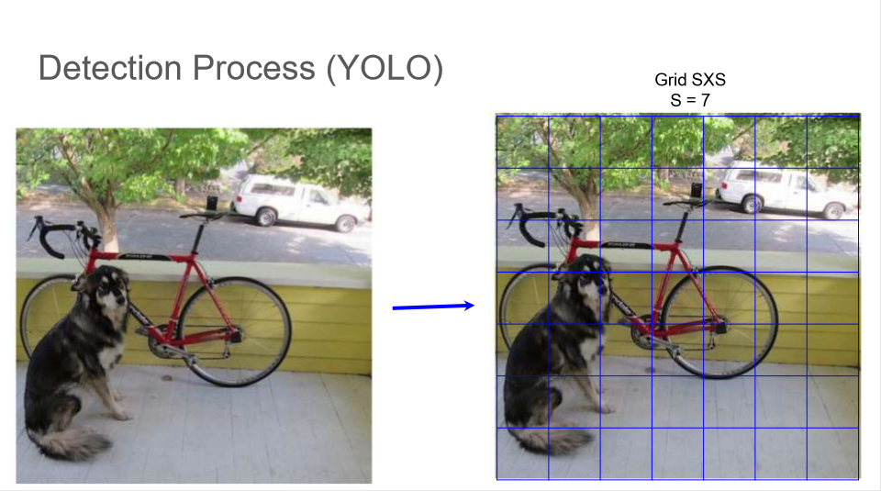

Slide 6
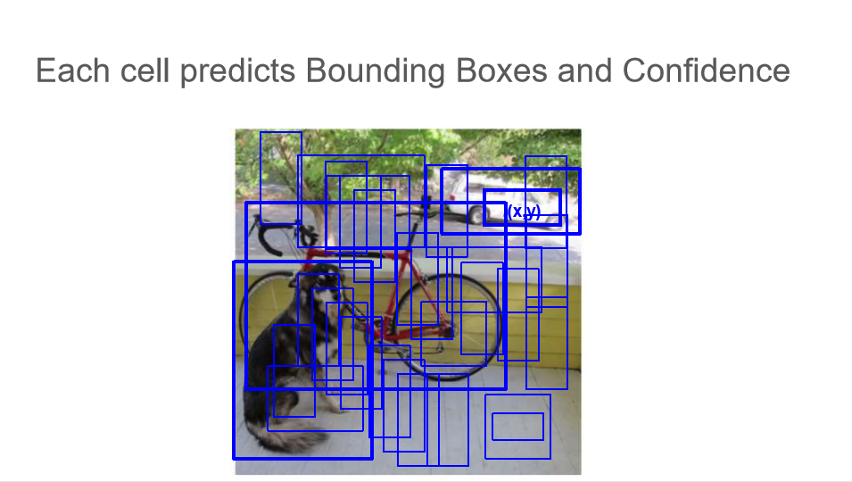

Slide 7
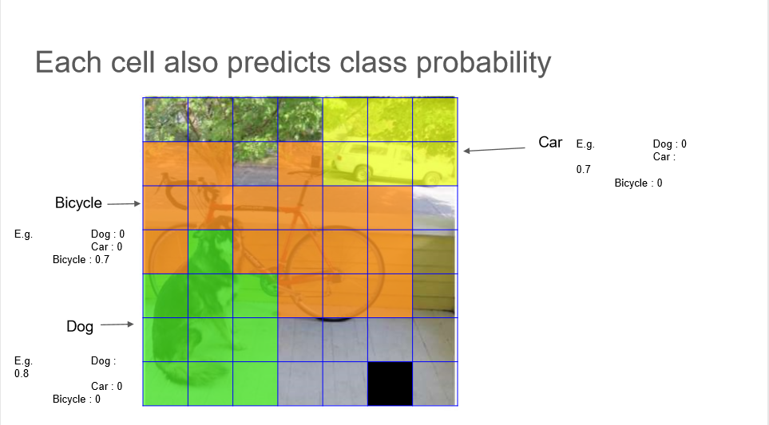

Slide 8
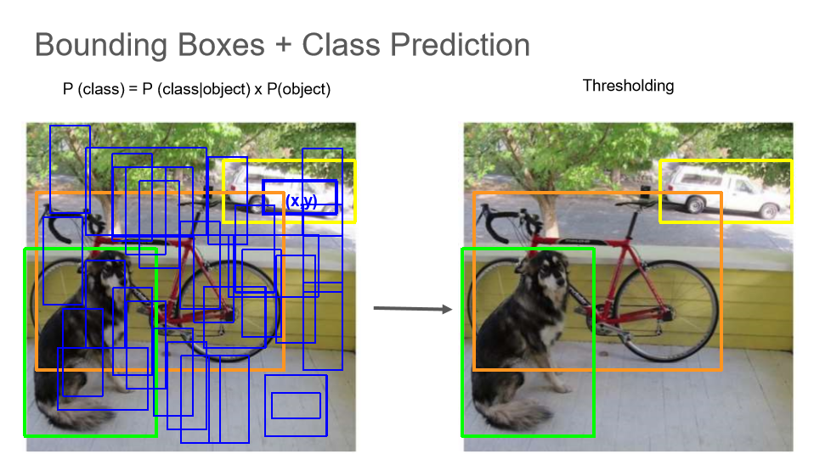

Slide 9
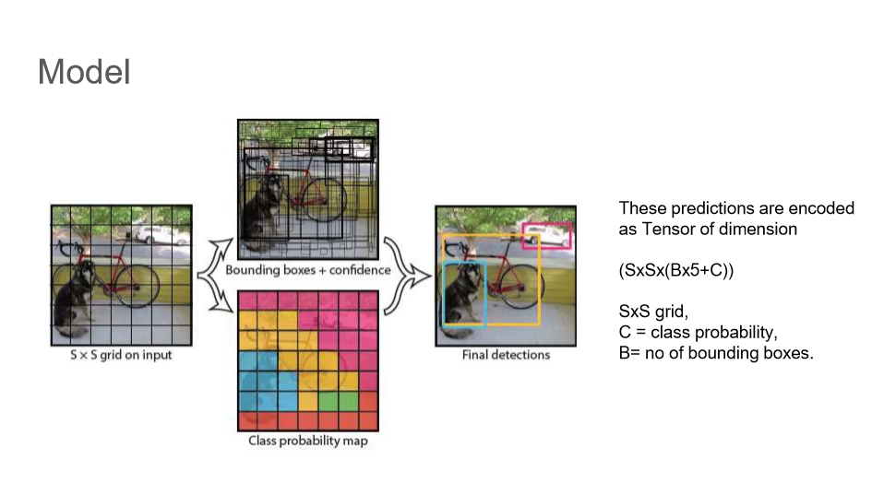

Slide 10
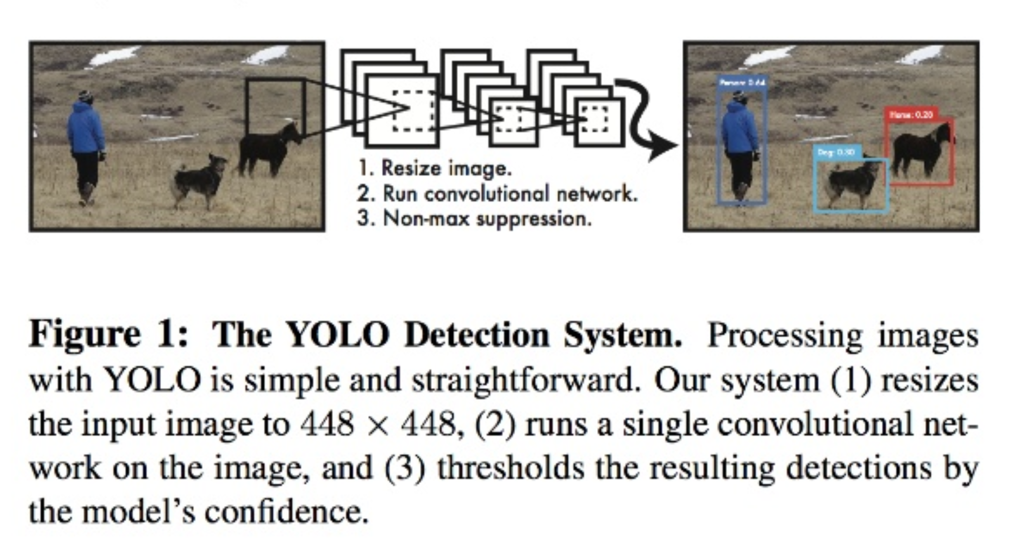

Slide 11
Neural Network Layers
The trained dataset is in yolov3.cfg file.
Here is a brief explanation of the variables in the dataset file
batch: That many images+labels are used in the forward pass to compute a gradient and update the weights via backpropagation.
subdivisions: The batch is subdivided in this many "blocks". The images of a block are ran in parallel on the gpu.
decay: Maybe a term to diminish the weights to avoid having large values. For stability reasons I guess.
channels: Better explained in this image :

Slide 12
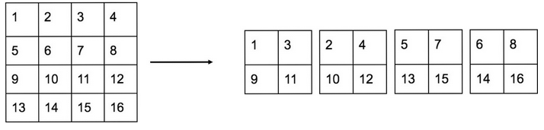
On the left we have a single channel with 4x4 pixels, The reorganization layer reduces the size to half then creates 4 channels with adjacent pixels in different channels

Slide 13
Dataset used
The trained dataset is in file yolov3.weights.
Weights and biases are the learnable parameters of your model. As well as neural networks, they appear with the same names in related models such as linear regression. Most machine learning algorithms include some learnable parameters like this.
The values of these parameters before learning starts are initialised randomly (this stops them all converging to a single value). Then when presented with data during training, they are adjusted towards values that have correct output.

